Slide 1
CREDIT CARD UTILIZATION FORECAST
Credit Origination Process Analysis
Candidate: Firsov Viacheslav

Slide 2
Problem Statement
APPLICATION_DATE | AGREEMENT_DATE | UTILIZATION_DATE | CNT
14.06.2023 | 15.06.2023 | 15.06.2023 | 63
14.06.2023 | 15.06.2023 |  | 107
14.06.2023 |  |  | 319
15.06.2023 | 15.06.2023 | 15.06.2023 | 11
15.06.2023 | 15.06.2023 |  | 37
15.06.2023 |  |  | 453
Objectives:
Daily utilization forecast until 2023-07-31
Cumulative utilization forecast
Confidence intervals for predictions
Constraints:
Include clients without agreement
Accounting for new applications for card registration
Data as of 2023-06-15

Slide 3
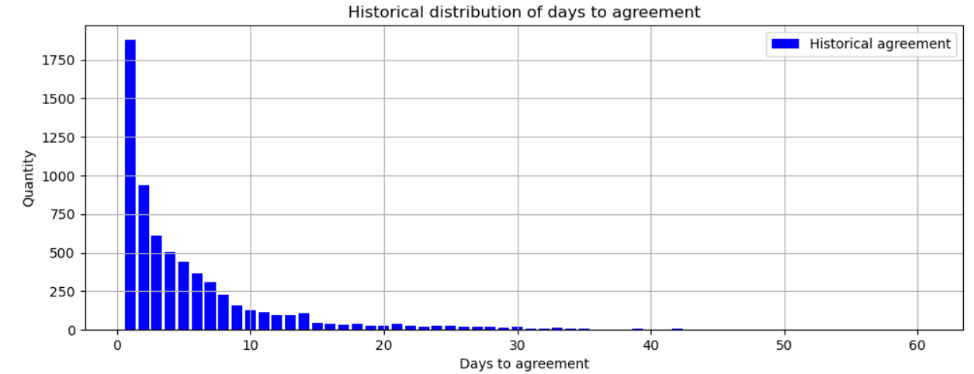
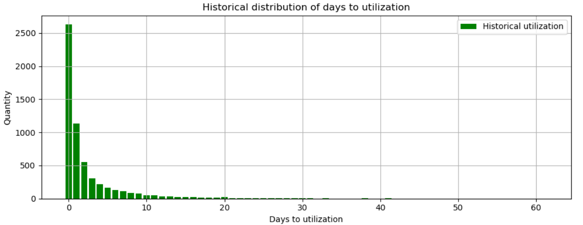
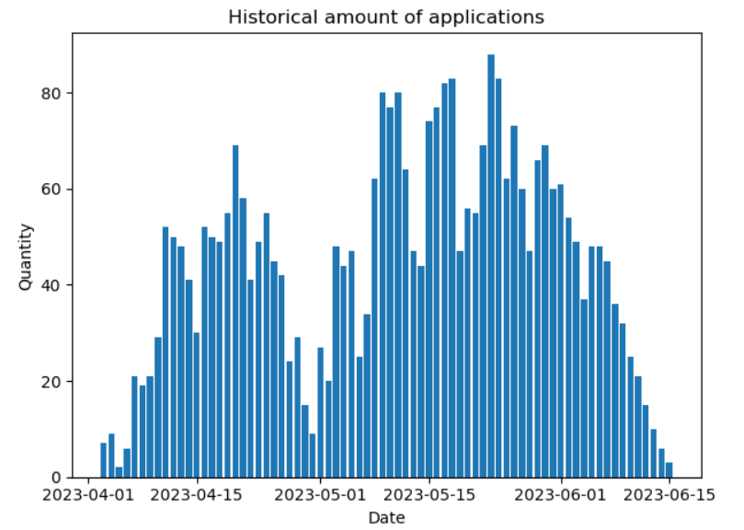


Analysis of historical data
High likelihood of card utilization by new clients post-15.06.2023 and clients without agreement until 15.06.2023
$$⇒$$
Key historical metrics:
Total clients = 14675
Agreement probability = 49%
Mean agreement time = 6 days
Mean utilization time = 3 days
Weekly seasonality patterns detected in historical application volumes
$$→$$

Slide 4
Methodology
New applications forecast:
SARIMA model + Poisson noise
Probabilistic process modeling:
Application → Agreement (binomial distribution)
Agreement → Utilization (empirical distribution)
Bootstrap aggregation:
500 iterations for confidence intervals
Comprehensive scenario coverage

Slide 5
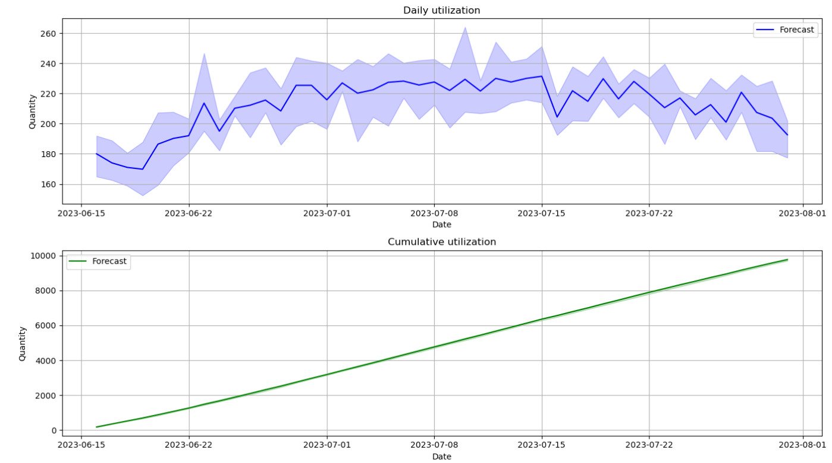
Forecast Results
Key findings:
Utilization peak: 04.07.2023 – 15.07.2023 (220-230 utilizations/day, max = 231 utilization)
Expected growth: 9700 ± 100 clients

Slide 6
Possible Improvements/Enhancements
Universal parameter tuning for SARIMA model
Accounting for other attributes in application approval/utilization day forecasts
Using autoregressive sieve bootstrap method for predictions

